Slide 1
High Level Grid Services
Warren Smith
Texas Advanced Computing Center
University of Texas

Slide 2
Outline
Grid Monitoring
  Ganglia
  MonALISA
  Nagios
  Others
Workflow
  Condor DAGMan (and Condor-G)
  Pegasus
Data
  Storage Resource Broker
  Replica Location Service
  Distributed file systems

Slide 3
Other High Level Services
(Not Covered)
Resource Brokering
Metascheduling
  GRMS, MARS
Credential issuance
  PURSE, GAMA
Authorization
  Shibboleth
  VOMS
  CAS

Slide 4
Grid Monitoring
Ganglia
MonALISA
Nagios
Others

Slide 5
Ganglia http://ganglia.sourceforge.net
Monitors clusters and aggregations of clusters
Collects system status information
  Provided in XML documents
  Provides it graphically via a web interface
Can be subscribed to and aggregated across multiple clusters
Focus on simplicity and performance
  Can monitor 1000s of systems
MDS, MonALISA can consume information provided by Ganglia

Slide 6
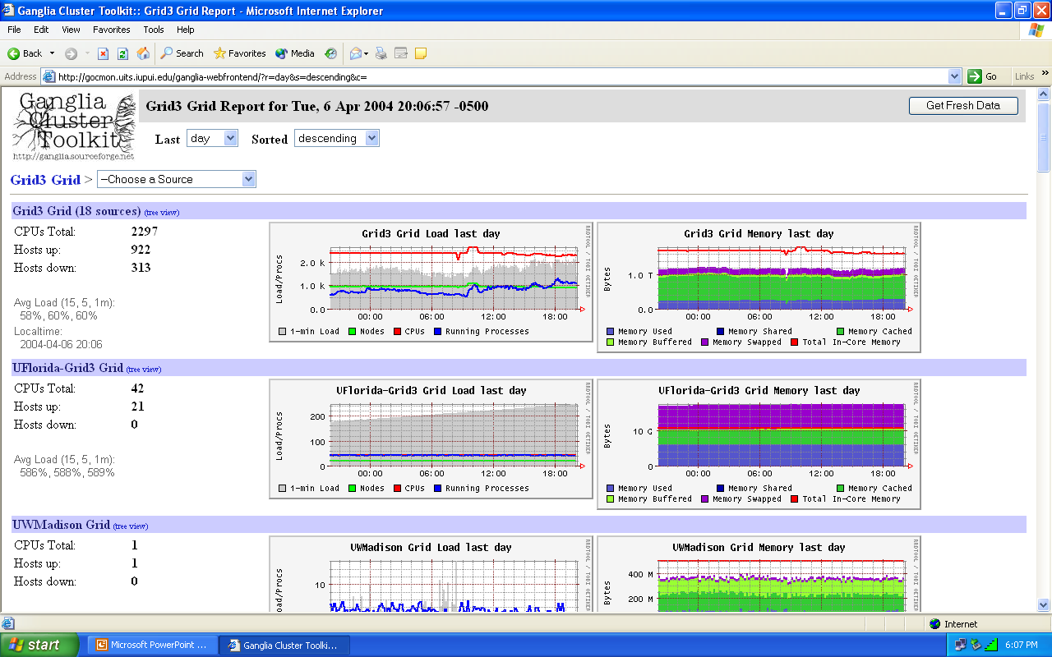

Slide 7
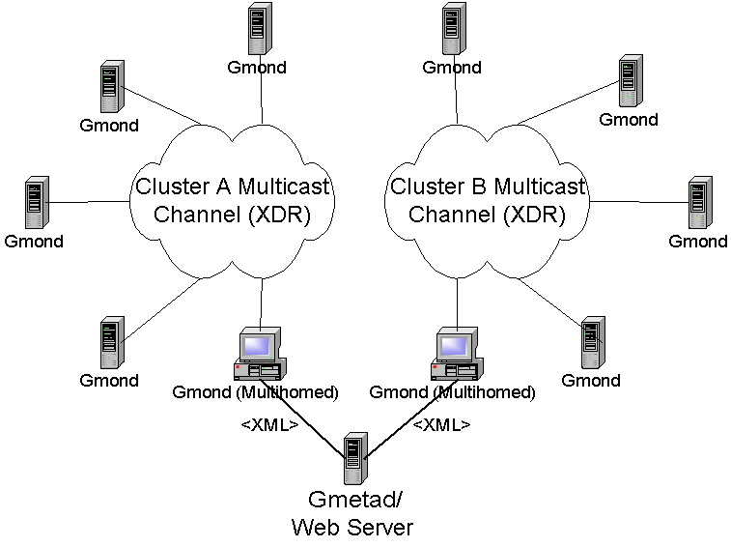
Notes:
This is just a very simple diagram showing gmetad running on a host with a web server and linking together two unique multicast domains.
It's important to note that you do not need to use private address space and have a multihomed host to use ganglia. This is only a typical setup.
Also, you can easily build hierarchies that extend over the globe by using another gmetad which links into more gmetad and gmond.

Slide 8
gmond
Ganglia Monitoring Daemon
Runs on each resource being monitored
Collects a standard set of information
Configuration file specifies
  When to collect information
  When to send
    Based on time and/or change
  Who to send to
  Who to allow to request
Supports UDP unicast, UDP multicast, TCP

Slide 9
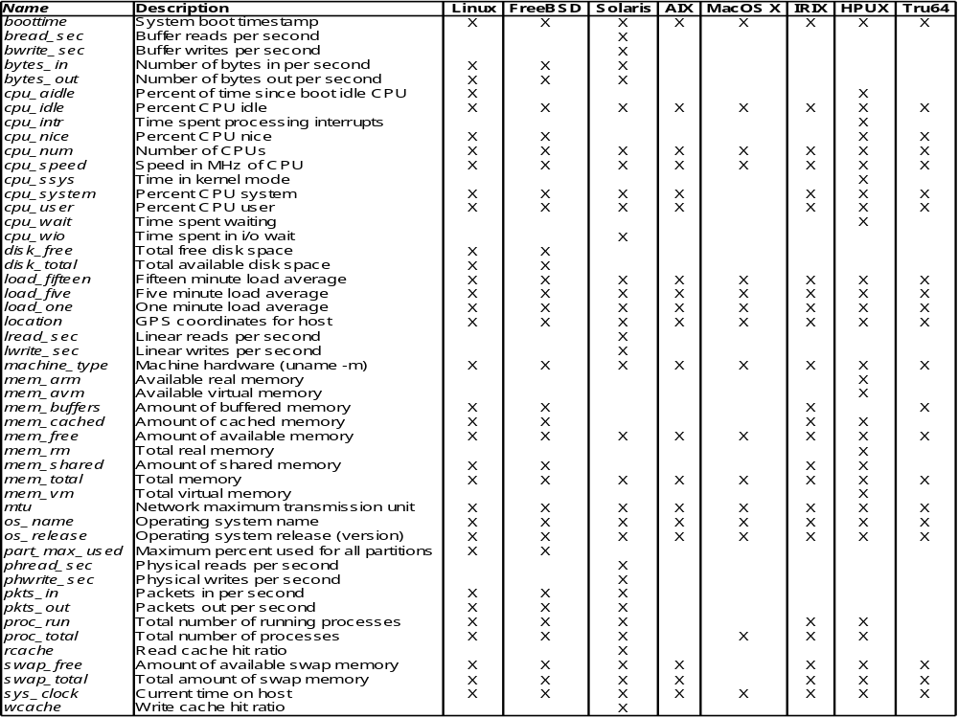
Information collected by gmond

Slide 10
gmetric
Program to provide custom information to Ganglia
  e.g. CPU temperature, batch queue length
Uses the gmond configuration file to determine who to send to
Executed as a cron job
  Execute command(s) to gather the data
  Execute gmetric to send data

Slide 11
gmetad
Aggregates information from gmonds
Configuration file specifies which gmonds to get data from
  Connects to gmonds using TCP
Stores information in Round Robin Database (RRD)
  Small database where data for each attribute is stored in time order
  Maximum size
  Oldest data is forgotten
PHP scripts to display RRD data as web pages
  Graphs over time

Slide 12
Who’s Using Ganglia?
Planet Lab
Lots of clusters
  SDSC
  NASA Goddard
  Naval Research Lab
  …

Slide 13
MonALISA http://monalisa.cacr.caltech.edu
Distributed monitoring system
Agent-based design
Written in Java
Uses JINI & SOAP/WSDL
  Locating services & communicating
Gathers information using other systems
  SNMP, Ganglia, MRTG, Hawkeye, custom
Clients
  Locate and subscribe to services that provide monitoring information
  GUI client, web client, administrative client

Slide 14
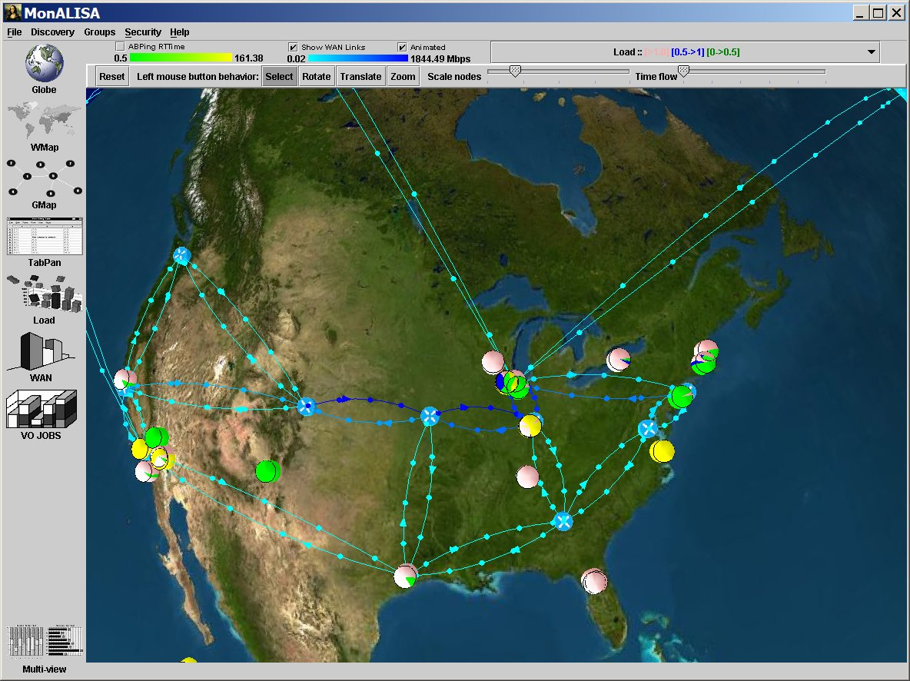
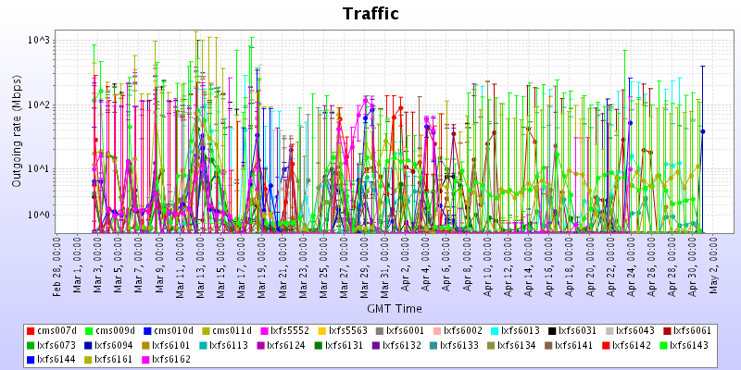
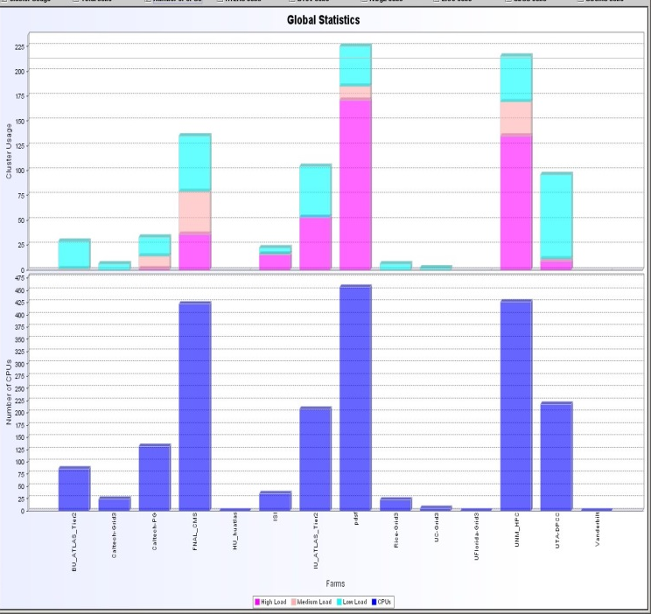
Monitoring I2 Network Traffic,
Grid03 Farms and Jobs

Slide 15
MonALISA Services
Autonomous, self-describing services
  Built on a generic Dynamic Distributed Services Architecture
Each monitoring service stores data in a relational database
Automatic update of monitoring services
Lookup discovery service

Slide 16
Who’s using MonALISA?
Open Science Grid
  Included in the Virtual Data Toolkit
Internet2
ABILENE
Compact Muon Solenoid
Many others

Slide 17
Nagios Overview
A monitoring framework
  Configurable
  Extensible
Provides a relatively comprehensive set of functionality
Supports distributed monitoring
Supports taking actions in addition to monitoring
Large community using and extending
Doesn’t store historical data in a true database
Quality of add-ons varies

Slide 18
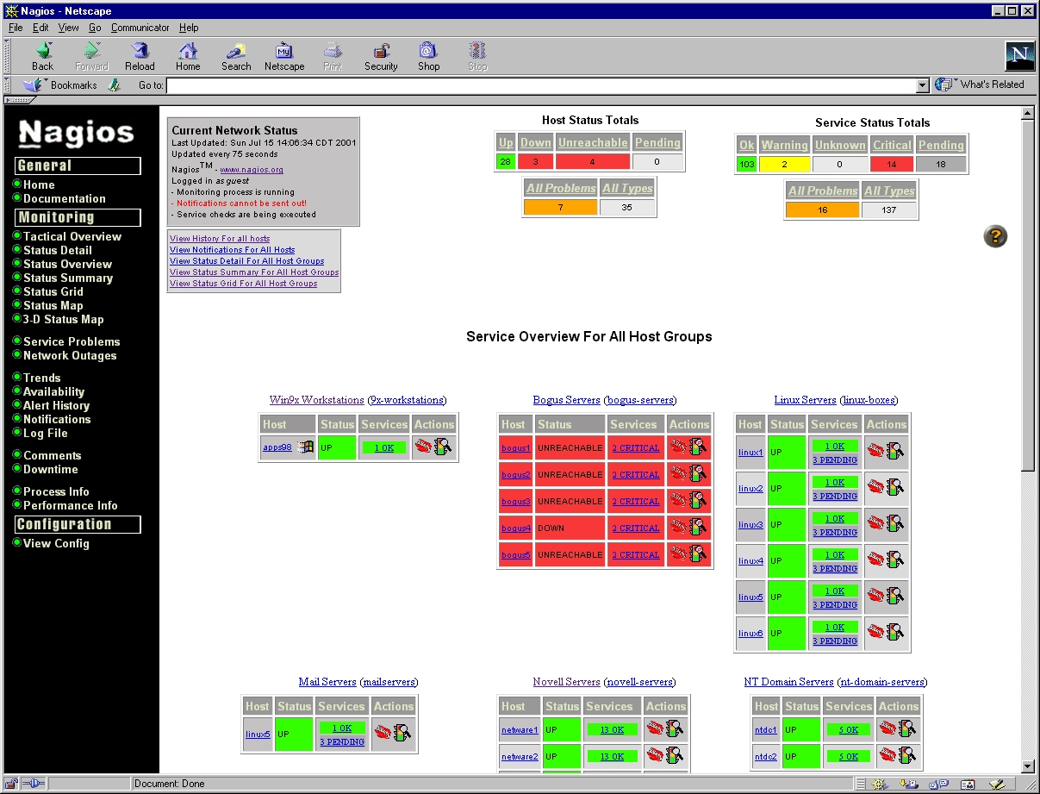

Slide 19
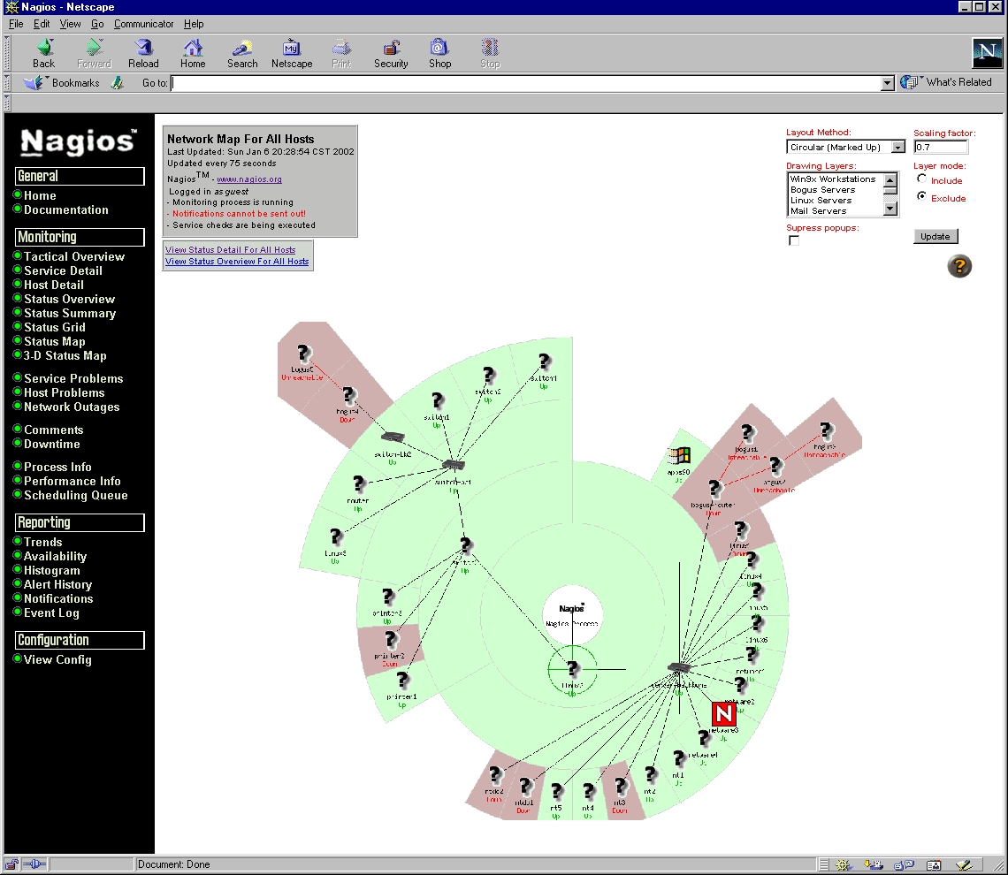

Slide 20
Architecture
httpd
Nagios CGIs
Nagios configuration files
Nagios log files
send_nsca
Nagios configuration files
NSCA
send_ncsa
Nagios
Nagios configuration files
Nagios
Nagios
Nagios plugins
Nagios plugins
Remote system
Remote system
Nagios plugins
Central collector

Slide 21
Nagios Features I
Web interface
  Current status, graphs
Monitoring
  Monitoring of a number of properties included
  People provide plugins to monitor other properties, we can do the same
  Periodic monitoring w/ user-defined periods
Thresholds to indicate problems
Actions when problems occur
  Notification
    Email, page, extensible
  Actions to attempt to fix problem (e.g. restart a daemon)

Slide 22
Nagios Features II
Escalations
  If a problem occurs n times do x
    Attempt to fix automatically
  If a probem occurs more than n times do y
    Ticket in to trouble ticket system
  …
Distributed monitoring
  A Nagios daemon can test things all over
  Can also have Nagios daemons on multiple systems
    Certain daemons can act as central collection points

Slide 23
Who’s Using Nagios?
It’s included in a number of Unix distros
  Debian
  SUSE
  Gentoo
  OpenBSD
Nagios users can register with the site
  986 sites have registered
  ~200,000 hosts monitored
  ~720,000 services monitored

Slide 24
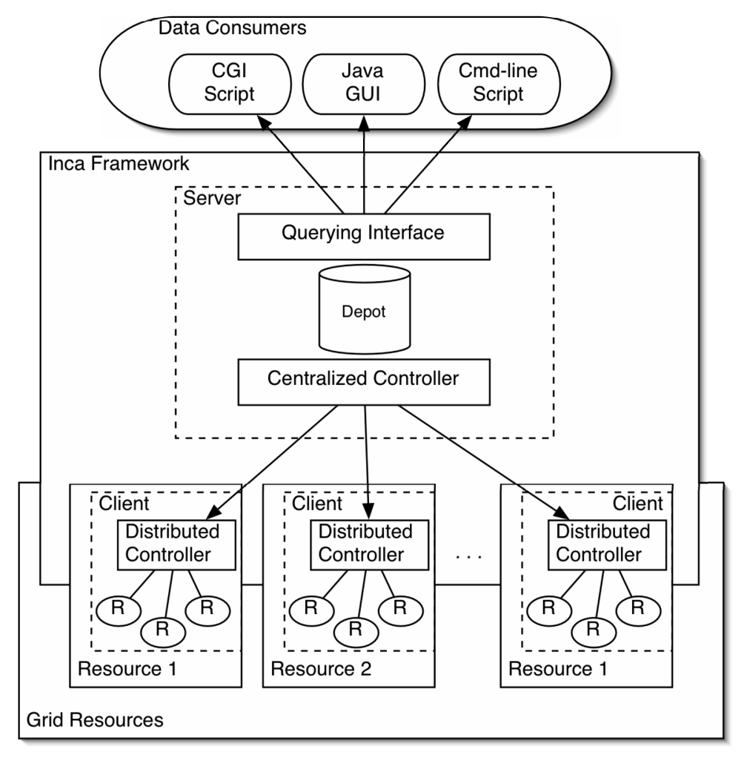
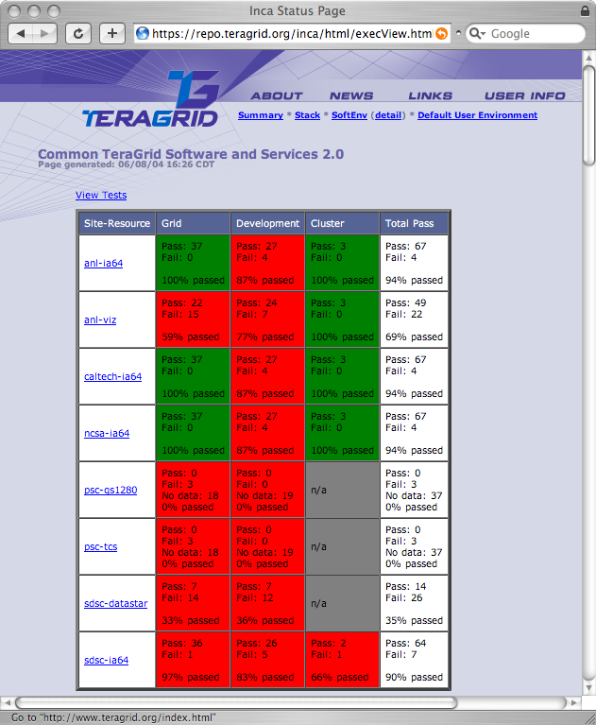
TeraGrid’s Inca
Hierarchical Status Monitoring
  Groups tests into logical sets
  Supports many levels of detail and summarization
Flexible, scalable architecture
  Very simple reporter API
  Can use existing test scripts (unit tests, status tools)
  Hierarchical controllers
  Several query/display tools

Slide 25
And Many Others…
SNMP
  OpenNMS
  HP OpenView
Big Brother / Big Sister
Globus MDS
ACDC (U Buffalo)
GridCat
GPIR (TACC)
…

Slide 26
Workflow
Condor DAGMan
  Starting with Condor-G
Pegasus

Slide 27
Workflow Definition
Set of tasks with dependencies
Tasks can be anything, but in grids:
  Execute programs
  Move data
Dependencies can be
  Control - “do T2 after T1 finishes”
  Data - “T2 input 1 comes from T1 output 1”
Can be acyclic or have cycles/iterations
Can have conditional execution
A large variety of types of workflows

Slide 28
Condor-G: Condor + Globus http://www.cs.wisc.edu/condor
Submit your jobs to condor
  Jobs say they want to run via Globus
Condor manages your jobs
  Queuing, fault tolerance
Submits jobs to resources via Globus

Slide 29
Globus Universe
Condor has a number of universes
  Standard - to take advantage of features like checkpointing and redirecting file I/O
  Vanilla - to run jobs without the frills
  Java - to run java codes
Globus universe to run jobs via Globus
  Universe = Globus
  Which Globus Gatekeeper to use
  Optional: Location of file containing your Globus certificate
  universe = globus
  globusscheduler = beak.cs.wisc.edu/jobmanager
  executable = progname
  queue

Slide 30
How Condor-G Works
Personal Condor
Globus Resource
Schedd
LSF
Queues, submits, and manages jobs
Available commands:
  condor_submit, condor_rm, condor_q,
  condor_hold, …
Manages cluster resources

Slide 31
How Condor-G Works
600 Globus
jobs
Personal Condor
Globus Resource
Schedd
LSF

Slide 32
How Condor-G Works
600 Globus
jobs
Personal Condor
Globus Resource
Schedd
LSF
GridManager

Slide 33
How Condor-G Works
600 Globus
jobs
Personal Condor
Globus Resource
JobManager
Schedd
LSF
GridManager

Slide 34
How Condor-G Works
600 Globus
jobs
Personal Condor
Globus Resource
JobManager
Schedd
LSF
GridManager
User Job

Slide 35
Globus Universe Fault Tolerance
Submit side failure:
  All relevant state for each submitted job is stored persistently in the Condor job queue.
  This persistent information allows the Condor GridManager upon restart to read the state information and reconnect to JobManagers that were running at the time of the crash.
Execute side:
  Condor worked with Globus to improve fault tolerance
X.509 proxy expiration
  Condor can put jobs on hold and email user to refresh proxy

Slide 36
Condor DAGMan
Directed Acyclic Graph Manager
DAGMan allows you to specify the dependencies between your Condor jobs, so it can manage them automatically for you.
(e.g., “Don’t run job “B” until job “A” has completed successfully.”)
Notes:
In the simplest case…

Slide 37
What is a DAG?
A DAG is the data structure used by DAGMan to represent these dependencies.
Each job is a “node” in the DAG.
Each node can have any number of “parent” or “children” nodes – as long as there are no loops!
Job A
Job B
Job C
Job D
Notes:
a DAG is the best data structure to represent a workflow of jobs with dependencies
children may not run until their parents have finished – this is why the graph is a directed graph … there’s a direction to the flow of work
In this example, called a “diamond” dag, job A must run first; when it finishes, jobs B and C can run together; when they are both finished, D can run; when D is finished the DAG is finished
Loops, where two jobs are both descended from one another, are prohibited because they would lead to deadlock – in a loop, neither node could run until the other finished, and so neither would start – this restriction is what makes the graph acyclic

Slide 38
Defining a DAG
A DAG is defined by a .dag file, listing each of its nodes and their dependencies:
  # diamond.dag
  Job A a.sub
  Job B b.sub
  Job C c.sub
  Job D d.sub
  Parent A Child B C
  Parent B C Child D
Each node will run the Condor job specified by
its accompanying Condor submit file
Each node can have a pre and post step
Job A
Job B
Job C
Job D
Notes:
This is all it takes to specify the example “diamond” dag

Slide 39
Submitting a DAG
To start your DAG, just run condor_submit_dag with your .dag file, and Condor will start a personal DAGMan daemon which to begin running your jobs:
  % condor_submit_dag diamond.dag
condor_submit_dag submits a Scheduler Universe Job with DAGMan as the executable.
Thus the DAGMan daemon itself runs as a Condor job, so you don’t have to baby-sit it.
Notes:
Just like any other Condor job, you get fault tolerance in case the machine crashes or reboots, or if there’s a network outage
And you’re notified when it’s done, and whether it succeeded or failed
% condor_q
-- Submitter: foo.bar.edu : <128.105.175.133:1027> : foo.bar.edu
ID OWNER SUBMITTED RUN_TIME ST PRI SIZE CMD
2456.0 user 3/8 19:22 0+00:00:02 R 0 3.2 condor_dagman -f -

Slide 40
Running a DAG
DAGMan manages the submission of your jobs to Condor based on the DAG dependencies.
  Can configure throttling of job submission
In case of a failure, DAGMan creates a “rescue” file with the current state of the DAG.
  Failures can be retried a configurable number of times
  The rescue file can be used to restore the prior state of the DAG when restarting
Once the DAG is complete, the DAGMan job itself is finished, and exits
Notes:
First, job A will be submitted alone…

Slide 41
Who’s Using Condor-G & DAGMan?
Pegasus
LIGO, Atlas, CMS, …
gLite
TACC
DAGMan available on every Condor pool

Slide 42
Pegasus http://pegasus.isi.edu
Pegasus - Planning for Execution on Grids
  Intelligently decide how to run a workflow on a grid
Take as input an abstract workflow
  Abstract DAG in XML (DAX)
Generates concrete workflow
  Select computer systems (MDS)
  Select file replicas (RLS)
Executes the workflow (Condor Dagman)

Slide 43
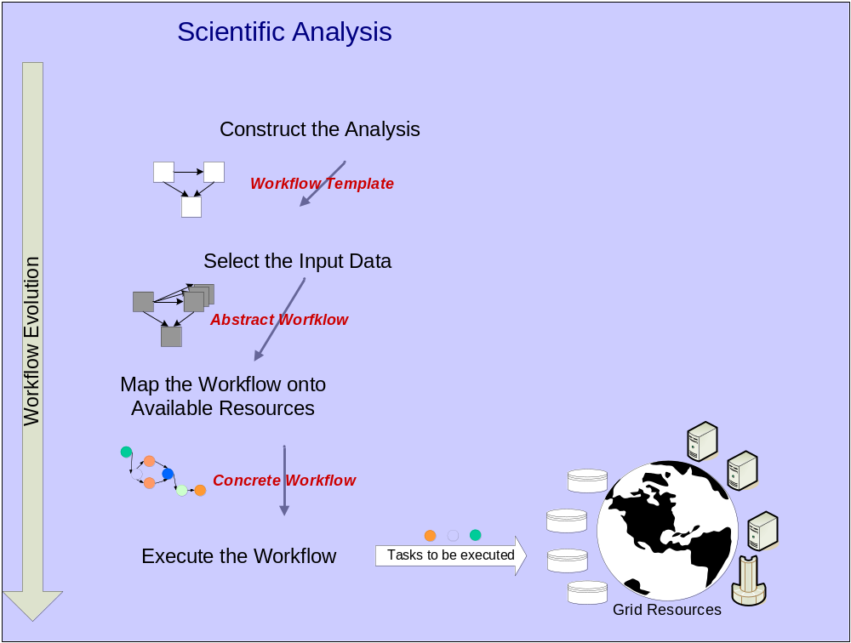
Science Gateway
Pegasus
Condor

Slide 44
Pegasus Workflows
Abstract workflow
  Edges are data dependencies
    Implicit data movement
  Processing on the data
Concrete workflow
  Edges are control flow
    Explicit data movement as tasks
Acyclic
Supports parallelism

Slide 45
Who’s Using Pegasus?
LIGO
Atlas High energy physics application
Southern California Earthquake Center (SCEC)
Astronomy: Montage and Galaxy Morphology applications
Bioinformatics
Tomography

Slide 46
Data
Storage Resource Broker
Replica Location Service

Slide 47
Storage Resource Broker (SRB) http://www.sdsc.edu/srb
Manages collections of data
  In many cases, the data are files
Provides a logical namespace
Maps logical names to physical instances
Associates metadata with logical names
  Metadata Catalog (MCat)
Interfaces to variety of storage
  Local disk
  Parallel file systems
  Archives
  Databases

Slide 48
SRB Client Implementations
A set of Basic APIs
  Over 160 APIs
  Used by all clients to make request to servers
Scommands
  Unix like command line utilities for UNIX and Window platforms
  Over 60 - Sls, Scp, Sput, Sget …

Slide 49
SRB Client Implementations
inQ – Window GUI browser
Jargon – Java SRB client classes
  Pure Java implementation
mySRB – Web based GUI
  run using web browser
Java Admin Tool
  GUI for User and Resource management
Matrix – Web service for SRB work flow

Slide 50
Example Read
Peer-to-peer Brokering
Read Application
Logical Name
7
1
7
SRB
server
SRB
server
3
4
6
SRB agent
SRB agent
2
5
5
R1
1.Logical-to-Physical mapping
2.Identification of Replicas
3.Access & Audit Control
MCAT
Data Access
R2
Notes:
19

Slide 51
Authentication
Grid Security Infrastructure
  PKI certificates
Challenge-response mechanism
  No passwords sent over network
Ticket
  Valid for specified time period or number of accesses
Generic Security Service API
  Authentication of server to remote storage

Slide 52
Authorization
Collection-owned data
  At each remote storage system, an account ID is created under which the data grid stores files
User authenticates to SRB
SRB checks access controls
SRB server authenticates to a remote SRB server
Remote SRB server authenticates to the remote storage repository

Slide 53
Metadata in SRB
SRB System Metadata
Free-form Metadata (User-defined)
  Attribute-Value-Unit Triplets…
Extensible Schema Metadata
  User Defined
  Tables integrated into MCAT Core Schema
External Database
Metadata operations
  Metadata Insertion through User Interfaces
  Bulk Metadata Insertion
  Template based Metadata Extraction
  Query Metadata through well defined Interfaces

Slide 54
Who’s Using SRB?
Very large number of users
A sample:
  National Virtual Observatory
  Large Hadron Collider
  NASA
  NCAR
  BIRN

Slide 55
Replica Location Service (RLS) http://www.globus.org/toolkit/data/rls/
Maintains a mapping from logical file names to physical file names
  1 logical file to 1+ physical files
Improves performance and fault tolerance when accessing data
Supports user-defined attributes of logical files
Component of Globus toolkit
  WS-RF service
RLS was designed and implemented in a collaboration between the Globus project and the EU DataGrid project

Slide 56
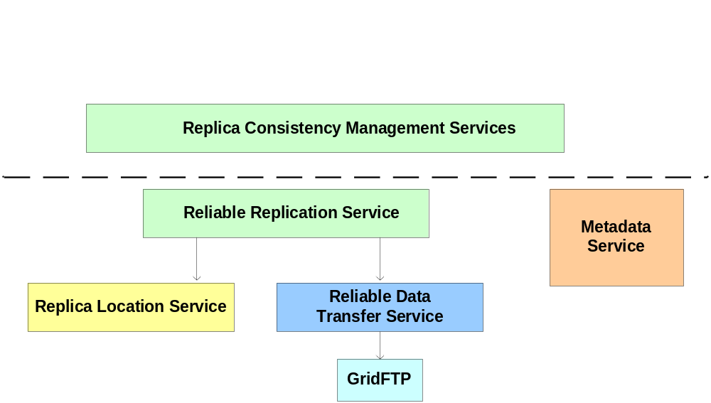
Replica Location Service In Context
RLS is one component in a data management architecture
Provides a simple, distributed registry of mappings
Consistency management provided by higher-level services

Slide 57
RLS Features
Replica Location Indexes
Local Replica Catalogs (LRCs) contain consistent information about logical-to-target mappings
RLI
RLI
LRC
LRC
LRC
LRC
LRC
Local Replica Catalogs
Replica Location Index (RLI) nodes aggregate information about one or more LRCs
LRCs use soft state update mechanisms to inform RLIs about their state: relaxed consistency of index
Optional compression of state updates reduces communication, CPU and storage overheads

Slide 58
Who’s Using RLS?
Used with Pegasus and Chimera:
  LIGO
  Atlas High energy physics application
  Southern California Earthquake Center (SCEC)
  Astronomy: Montage and Galaxy Morphology applications
  Bioinformatics
  Tomography
Other RLS Users
  QCD Grid, US CMS experiment (integrated with POOL)

Slide 59
Distributed File Systems
What everyone would like
Hard to implement
Features that are needed
  Performance
  Fault tolerance
  Security
  Fine-grained authorization
  Access via Unix file system libraries and programs
  User-defined metadata
    Some would like this

Slide 60
Example Distributed File Systems
AFS & DFS
  Kerberos for security
  Performance and fault tolerance problems
NFS
  Performance, security, and fault tolerance problems
NFSv4
  Tries to imporve performance and security
GridNFS
  Univ of Michigan
  Extend NFSv4
  Add grid security and improve performance
IBM GPFS
  Originally designed as a cluster parallel file system
  Being used in distributed environments
  Relatively large hardware requirements

Slide 61
Summary
Grid Monitoring
  Ganglia
  MonALISA
  Nagios
  Others
Workflow
  Condor DAGMan (and Condor-G)
  Pegasus
Data
  Storage Resource Broker
  Replica Location Service
  Distributed file systems

